Slide 1
Merge Sort

Slide 2
Contents
Introduction to Merge Sort
Merge Sort Algorithm
Merge Sort Procedure
Complexity
Advantages and Disadvantages

Slide 3
Merge Sort
Merge sort is defined as a sorting algorithm that works by dividing an array into smaller subarrays, sorting each subarray, and then merging the sorted subarrays back together to form the final sorted array.

Slide 4
How does Merge Sort Work?
Step 1: Split the list in half to create two subsets.
Step 2: Continue to split the subsets in half, until only individual items remain.
Step 3: Merge individual items back together in pairs, putting them back together in order.
Step 4: Continue to merge the pairs together, with each subset being sorted in order.
Step 5: Once all subsets have been combined, the list should be in the correct order.

Slide 5
Merge Sort (Contd.)
Algorithm:
MERGE_SORT(arr, beg, end)
if beg < end
set mid = (beg + end)/2
MERGE_SORT(arr, beg, mid)
MERGE_SORT(arr, mid + 1, end)
MERGE (arr, beg, mid, end)
end of if
END MERGE_SORT

Slide 6
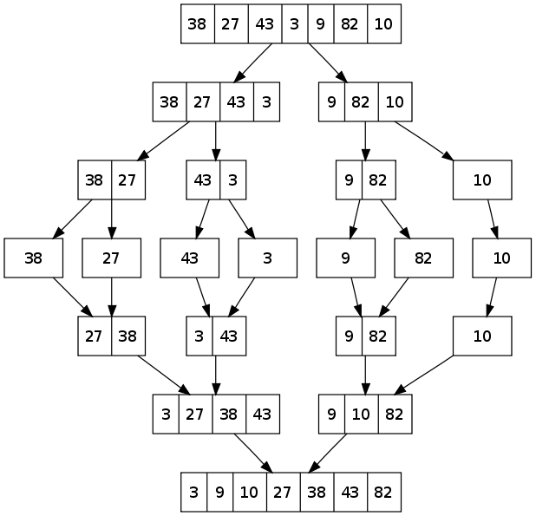
Merge Sort (Contd.)
Example of Merge sort

Slide 7
Merge Sort (Contd.)
Time complexity:
Best Case Complexity - It occurs when there is no sorting required, i.e. the array is already sorted. The best-case time complexity of merge sort is O(n*logn).
Average Case Complexity - It occurs when the array elements are in jumbled order that is not properly ascending and not properly descending. The average case time complexity of merge sort is O(n*logn).
Worst Case Complexity - It occurs when the array elements are required to be sorted in reverse order. That means suppose you have to sort the array elements in ascending order, but its elements are in descending order. The worst-case time complexity of merge sort is O(n*logn).

Slide 8
Merge Sort (Contd.)
Advantages:
Suitable for large data sets.
It is stable in nature and arranged the data in proper order. Merge sort never changes the order of the previous data.

Slide 9
Merge Sort (Contd.)
Disadvantages:
Not always suitable for small data sets.
The space complexity of merge sort is O(n). It is because, in merge sort, an extra variable is required for swapping.

Slide 10


